Slide 1
What makes a High Data Science Salary?
Data collected from Indeed.com

Slide 2
Key Predictors Found (caveat)
Firm’s Location
“Senior” title
“Quantitative” title (Maybe)

Slide 3
Methodology
Salaries from Indeed.com using high quality webscraper
Thousand per New York, Chicago, San+Francisco, Austin, Seattle, Los+Angeles, 'Philadelphia, Atlanta, Dallas, Pittsburgh, Portland, Phoenix' Denver, Houston, Miami, Boston
Around 1,000 results per city

Slide 4
Sklearn Modeling and Testing
A method for determining relationships between variables
Allows gauging of what factors will have the most contribution to a high or low salary
Two types used: Classifier and Regressor (Examples: Random Forest, K Nearest Neighbors, Random Forests)
Used train_test_split
Set “high” salaries above $108,750, the 50th percentile
Notes:
“A random forest is a meta estimator that fits a number of decision tree classifiers on various sub-samples of the dataset and use averaging to improve the predictive accuracy and control over-fitting.”

Slide 5
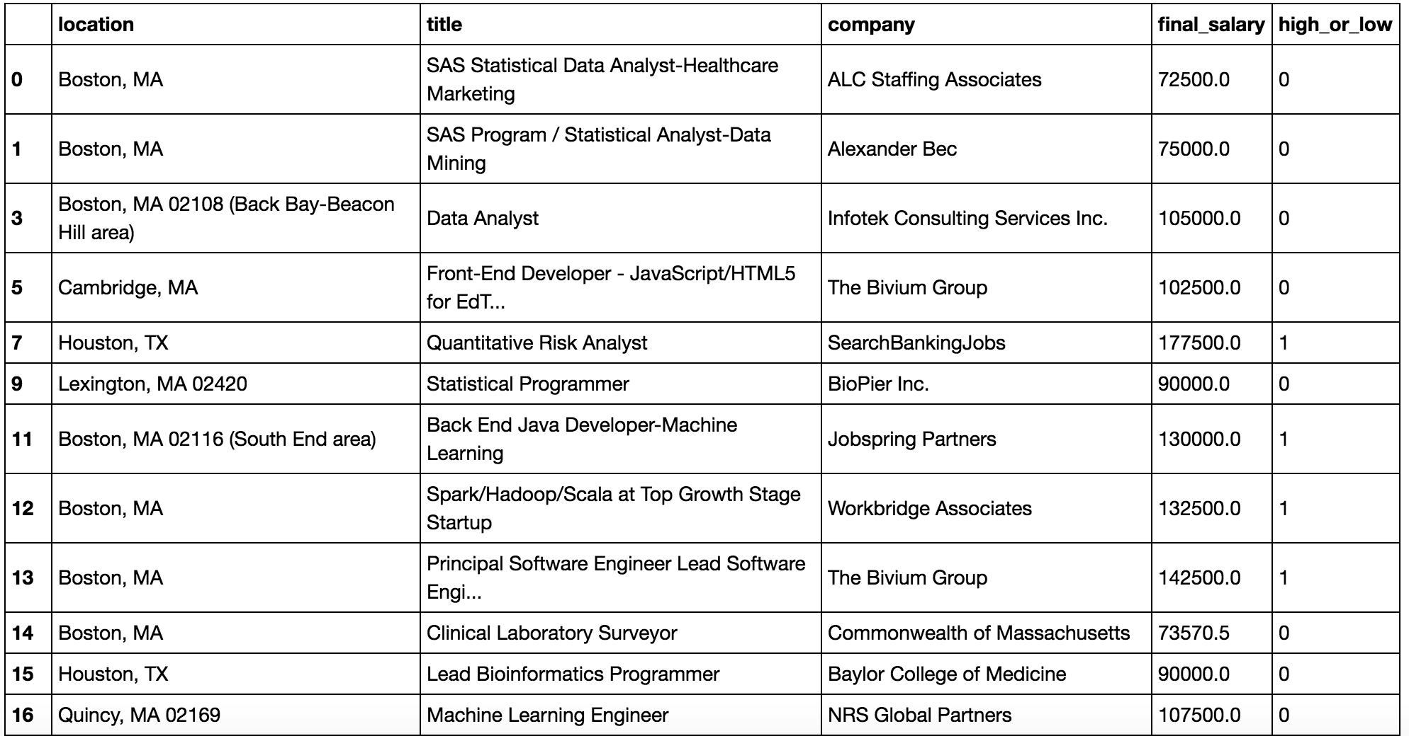

Slide 6
Results with Random Forests
Locations variable:
Accuracy Score: 0.88235
Cross Validation Score: 0.57
Seniors variable:
Accuracy Score: 0.647
Cross Validation Score: 0.5714
Quantitative variable:
Accuracy Score: 0.5882
Cross Validation Score: 0.428

Slide 7
Results with K Nearest Neighbors
Locations variable:
Accuracy Score: 0.5882
Cross Validation Score: 0.57
Seniors variable:
Accuracy Score: 0.5882
Cross Validation Score: 0.5714
Quantitative variable:
Accuracy Score: 0.5882
Cross Validation Score: 0.428
Notes:
Accuracy score must be because of limited results.

Slide 8
Recommendations
Limiting of Senior Staff could save our firm costs and increase dividends
Changing branch locations could save costs as well
More research required for the influence quantitative roles

Slide 9
Next Steps
Improve scraping methodology (include summaries)
Test for “quantitative”, “senior”, and other title features
Use other classifier modeling techniques

